Slide 1
Chapter 5: Model Based Design (DS, IMC & ZN)
Chapter 5: Model Based Design (DS, IMC & ZN)
EE4265 Tutorial Solutions

Slide 2
Chapter 5: Model Based Design (DS, IMC & ZN)
Question 1
Q1 - Given Information
Gp - plant transfer function (given).
Gv - valve transfer function. Gain is 0.5. Dynamics negligible.
G_{m} - level transmitter transfer function. Gain is 2.5.
Dynamics negligible.
G = G_{v} G_{m} G_{p} = 0.5 × 2.5 × ⁻
1.6 (1 − 0.5s )
−2 (1 − 0.5s )
=
s (3s + 1)
s (3s + 1)

Slide 3
Chapter 5: Model Based Design (DS, IMC & ZN)
Question 1
Q1 - Direct Synthesis Method
Fact
Direct Synthesis Method:
d stands for desired. Solve for G_{c} :

Slide 4
Chapter 5: Model Based Design (DS, IMC & ZN)
Question 1
Q1 - Trial 1 - Direct Synthesis
−2 (1 − 0.5s )
G =
s (3s + 1)
GGc
1
=
(desired closed loop )
1 + GGc
τc s + 1
Controller is unstable! Failed design.

Slide 5
Chapter 5: Model Based Design (DS, IMC & ZN)
Question 1
Q1 - Trial 2 - PD with pure differentiator
−2 (1 − 0.5s )
G =
s (3s + 1)
GGc
(1 − 0.5s )
=
(desired closed loop )
1 + GGc τc s + 1
1 (1 − 0.5s )
Gc =
G ^{x} (τ + 0.5) s
c
s (3s + 1)
(1 − 0.5s )
(3s + 1)
Gc =
x
= −
−2 (1 − 0.5s ) (τc + 0.5) s
(2τc + 1)
Pure Differentiator in the controller structure!

Slide 6
Chapter 5: Model Based Design (DS, IMC & ZN)
Question 1
Q1 - Trial 3 - PD with filter
−2 (1 − 0.5s )
G =
s (3s + 1)
1
GGc
(1 − 0.5s )
=
(desired closed loop )
1 + GG_{c} τ_{c} s + 1 ^{x} (3αs + 1)
1
(1 − 0.5s )
Gc =
G ^{x} [(τ s + 1) (3αs + 1) − (1 − 0.5s )]
c
1
(1 − 0.5s )
= x
G s [3ατc s + (τc + 3α + 0.5)]
s (3s + 1)
(1 − 0.5s )
Gc =
x
−2 (1 − 0.5s ) s [3ατc s + (τc + 3α + 0.5)]
(3s + 1)
⁼ ⁻ [6ατ s + 2 (τ + 3α + 0.5)]
c
c

Slide 7
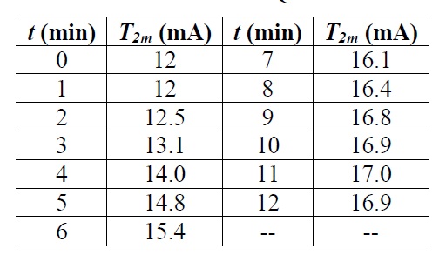
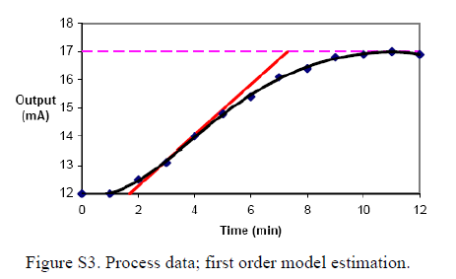
Chapter 5: Model Based Design (DS, IMC & ZN)
Question 2
Q2 - Empirical Modeling

Slide 8
Chapter 5: Model Based Design (DS, IMC & ZN)
Question 2
Q2 - IMC design - determine closed loop transfer function
Q is called the IMC controller
g_{m} = g_{p} = g
The loop equation is just,
Y (s ) = g U (s ) = [gQ ] Y_{sp} (s )

Slide 9
Chapter 5: Model Based Design (DS, IMC & ZN)
Question 2
Q2 - IMC design - Find Q
1
Specify desired transfer function and find Q ,
1
Qg ⁻ =
λs + 1
where g ⁻ is the invertible portion of g .
That is, g = g ⁺ g ⁻ where g ⁺ contains the non-invertible terms such as delay e ^{-Ls} or RHP zero (−θs + 1).
In the given example,
K
2
3
g ⁻ =
τ s + 1
g ⁺ = e ^{-Ls}

Slide 10
Chapter 5: Model Based Design (DS, IMC & ZN)
Question 2
Q2 - IMC design - Find gc
Now, given Q , the regular controller gc is:
Q
gc =
1 − Qg

Slide 11
Chapter 5: Model Based Design (DS, IMC & ZN)
Question 2
Q2 - IMC for FOPTD
Find Q :
K
1
^{Qg - = Q x} T s + 1 ⁼
(desired
λs + 1
closed
loop )
1
T s + 1
^{x} λs + 1
∴ Q =
Then, the controller g_{c} is:
Q
K
T s + 1
gc =
=
1 − Qg
K (λs + 1) − (T s + 1)
K
e ^{-Ls}
^{x} τs +1
1 T s + 1
= x
K (λ + L) s
T
1
=
x 1 +
K (λ + L)
T s

Slide 12
Chapter 5: Model Based Design (DS, IMC & ZN)
Question 2
Q2 - IMC for FOPTD
For the given question,
1.6538
e ^{-1.8s}
K
e ^{-Ls}
g (s ) =
≡
5.2s + 1
T s + 1
Therefore, gc by IMC design is:
T
1
gc =
x 1 +
T s
K (λ + L)
1
= 0.7146 x
1 +
5.2s
where λ was taken as ^{τ}/2.
Try simulating closed loop step response like with Q5!

Slide 13
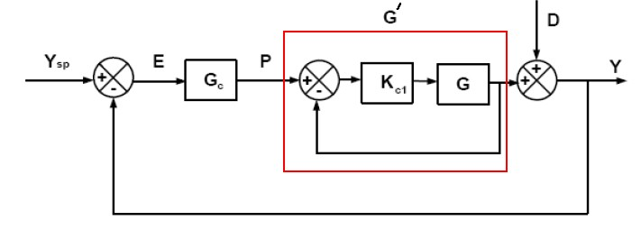
Chapter 5: Model Based Design (DS, IMC & ZN)
Question 3
Q3 - Unstable Process

Slide 14
Chapter 5: Model Based Design (DS, IMC & ZN)
Question 3
Q3 - Direct Synthesis

Slide 15
Chapter 5: Model Based Design (DS, IMC & ZN)
Question 4
Q4(a )(i) - DS - use Pade Approx on Controller
10.3
g =
(1.5s + 1)⁵ (15s + 1)
1
DS design:
2
Pade approximation of e ^{-Ls} is,

Slide 16
Chapter 5: Model Based Design (DS, IMC & ZN)
Question 4
Q4(a )(i ) - DS - use Pade Approx on Controller
3.
Simplify

Slide 17
Chapter 5: Model Based Design (DS, IMC & ZN)
Question 4
Q4(a )(ii ) - DS - use Pade Approx on Process
10.3
7.5s
g1 =
e ⁻
15s + 1
≈ g2 =
≡
Two Possibilities:
1
g2gc
=
1 + g2gc
2
g2gc
=
1 + g2gc

Slide 18
Chapter 5: Model Based Design (DS, IMC & ZN)
Question 4
Q4(a )(ii ) Possibility 1
So, using Pade Approx on controller (Q6 (a )(i )) and using
Pade Approx on Process (Q6 (a )(ii ) Possibility 1) both give
the same result.

Slide 19
Chapter 5: Model Based Design (DS, IMC & ZN)
Question 4
Q4(a )(ii ) Possibility 2 - gives standard PID

Slide 20
Chapter 5: Model Based Design (DS, IMC & ZN)
Question 4
Q4(b ) - IMC design
1
2

Slide 21
Chapter 5: Model Based Design (DS, IMC & ZN)
Question 4
Q4(b ) - IMC design
3.
Find gc :
This is identical to Q6 (a )(ii ) Possibility 2.

Slide 22
Chapter 5: Model Based Design (DS, IMC & ZN)
Question 5
Q5(a ) - Direct Synthesis
1
K
g =
≡
(3S + 1) (5S + 1)
2
3

Slide 23
Chapter 5: Model Based Design (DS, IMC & ZN)
Question 5
Q5(b , c)
Now, it is given that g is actually:
2K (-ξS + 1)
g =
(3S + 1) (5S + 1)
To examine stability,
1 + ggc = 0

Slide 24
Chapter 5: Model Based Design (DS, IMC & ZN)
Question 5
Q5(b , c)
Thus, the condition for stability is,
In part (b), it is given that , so, for stability,
ξ < 2
in part (c), it is given that ξ = 3.5, so, for stability,

